Slide 1
Multi-zone office building with hybrid system - INFRAX
Iago Cupeiro
IBPSA Project 1 Expert Meeting
Berlin, 27-28 Feb

Slide 2
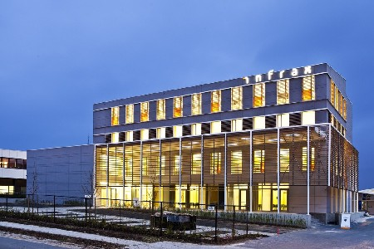
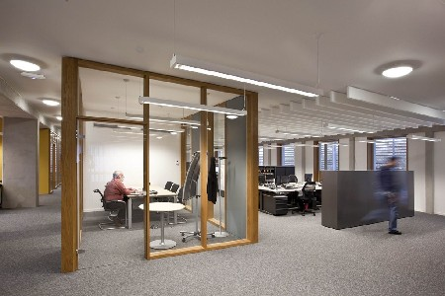
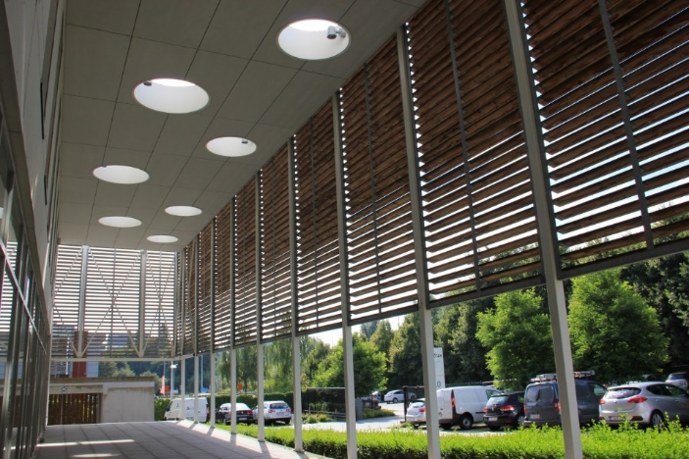
General information
2232 m² office building – 4 floors + basement (unheated)
Detailed floor, façade plans and hydronic/air schematics
Description of HVAC control system
Access to BMS terminal
Clean data storage starting from Feb 2018
Real MPC implementation by Sep 2018
Notes:
The INFRAX building is an 4-floor office building located in Dilbeek, Brussels. Detailed schematics allowed to describe a white-box model of the building in Dymola, both the envelope, the HVAC system and the RBC controller description. Within the framework of a parallel running project, the BMS terminal can be accessed to check the current status and measurements of the building, however data storage has been modified aiming to a real implementation of MPC by September 2018. The model is NOT validated with measurements.

Slide 3


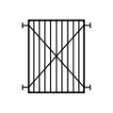



HVAC system
Supply
Transfer
Emission
Heating
Cooling
Notes:
Description of the HVAC system
The building heating supply system consists of two 70kW water-to-water heat pump, with two-stage compressors. The heat can be provided directly to the TABS of the building or by means of the ventilation system. The AHU pre-heat the air up to approx. 18 °C and a small heating coil in each the ducts can upgrade this heat to the desired level. The cooling system uses passive cooling as main source, however if the ground temperature goes too high either active cooling or a cooling tower will be activated. A heat exchanger will transfer the cooling to the TABS, and the AHU will transfer the cooling to the ventilation system.

Slide 4
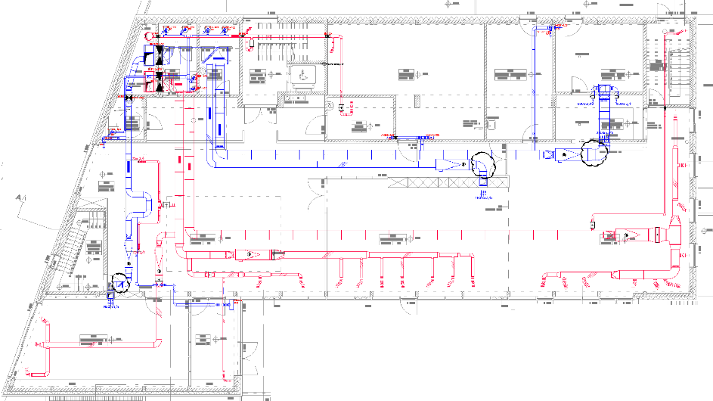
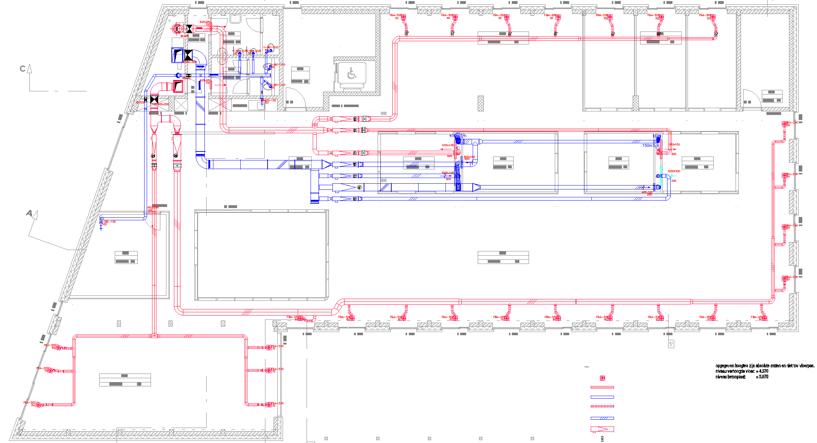
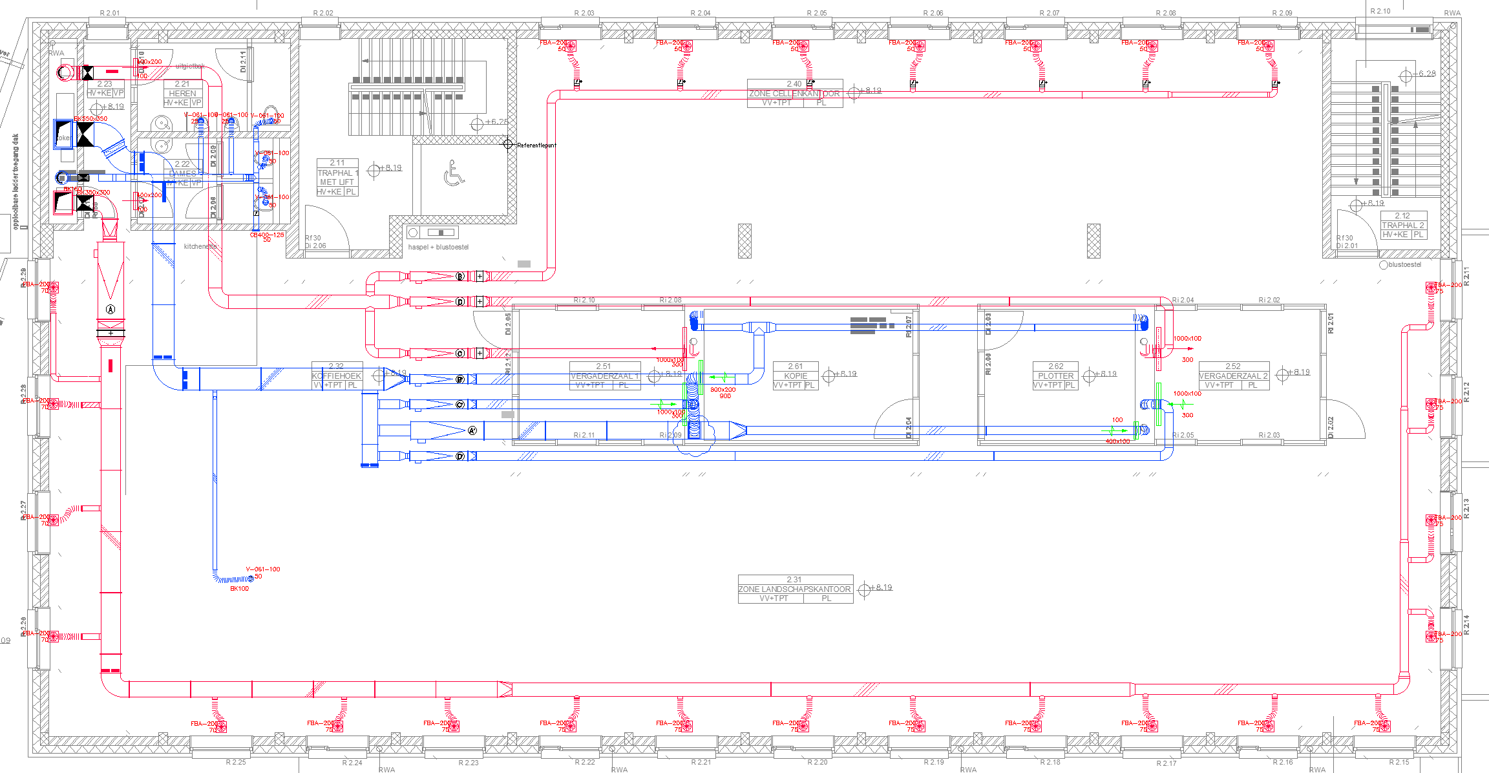
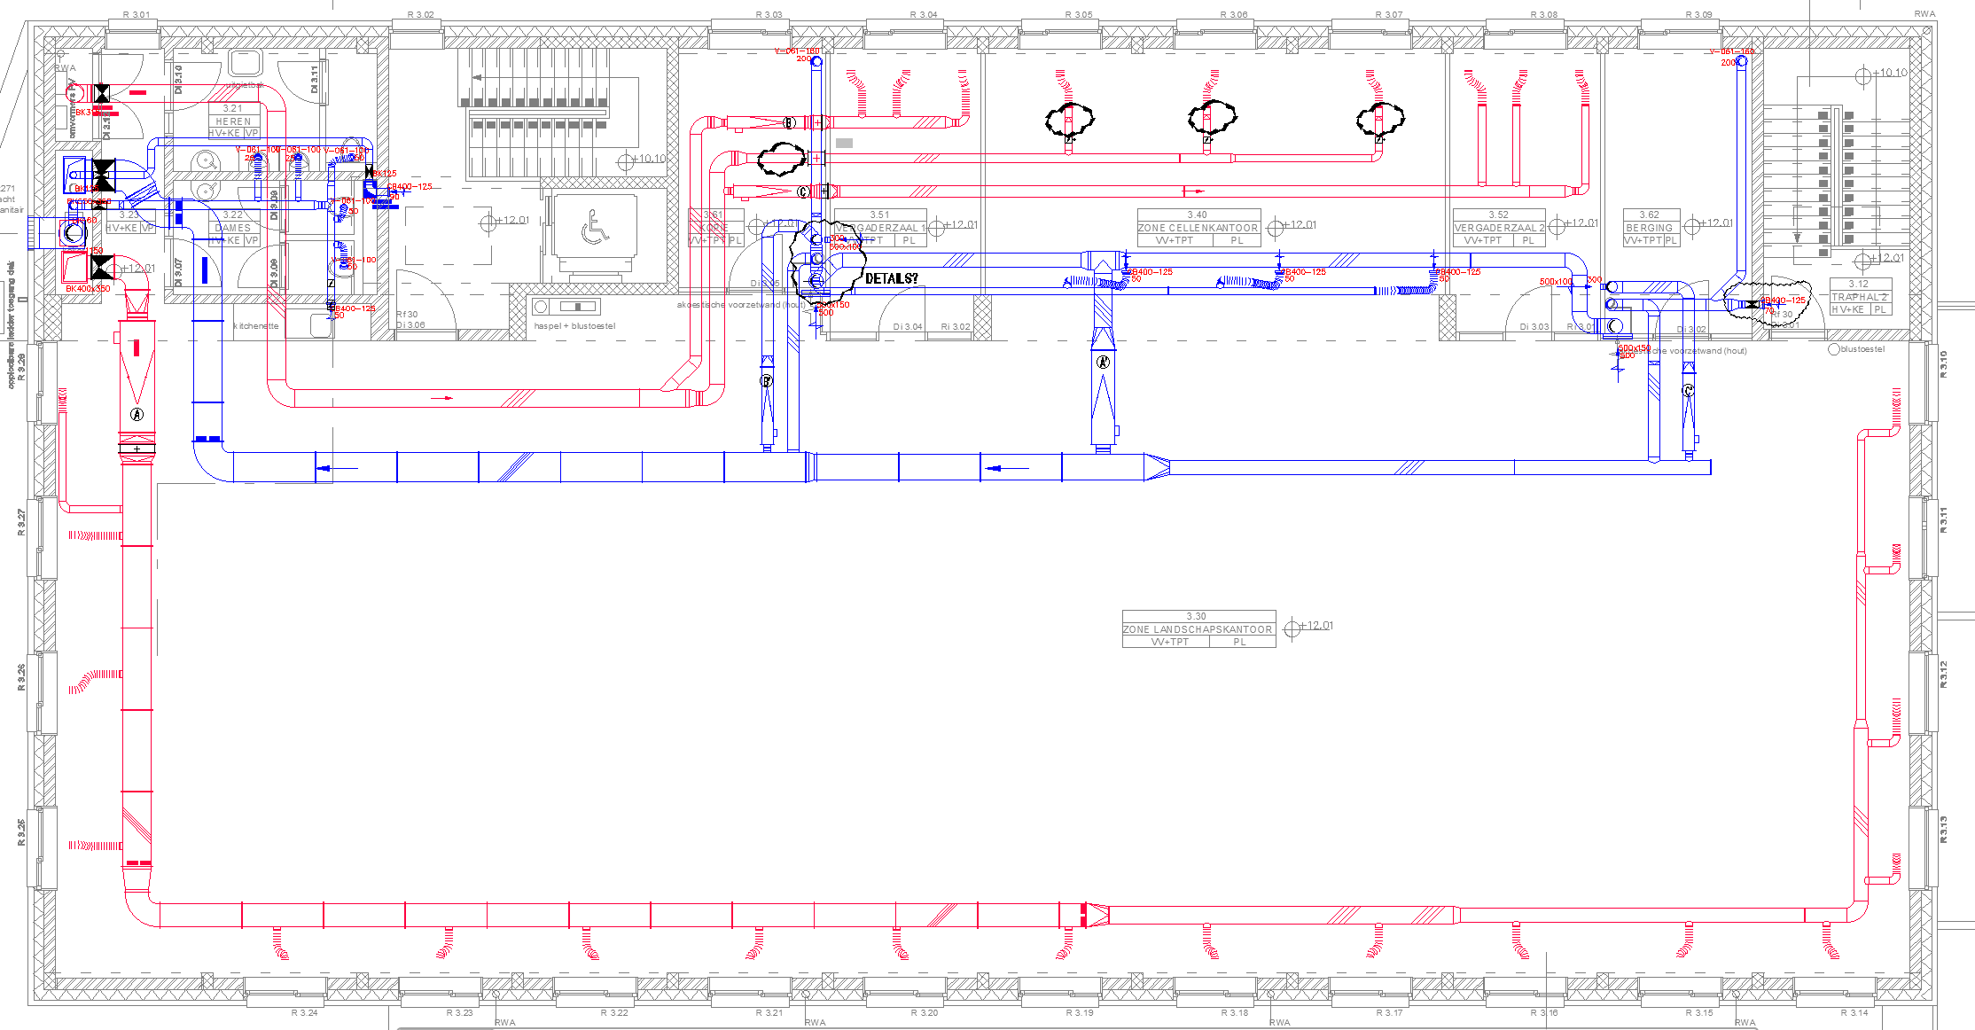
Zoning
Ground floor
First floor
Second floor
Third floor
Notes:
The building has four floors, schematically represented here.
The TABS is controlled in a per-floor basis: each floor has its main collector with a modulating two-way valve that regulates the water flow going through TABS
The duct distribution is what determines the zoning criteria of the building. Furthermore, some of the ducts have VAV boxes installed to control the flow. Therefore, based on this we have 27 zones (without the basement), 21 of them being directly heated by the ventilation.

Slide 5
Modelling approach 1
Simulation model – IDEAS and Buildings
Envelope – IDEAS.Buildings.Components.Zone/RectangularZone/InternalWall/OuterWall/Window....
Heat pump – IDEAS.Fluid.Production.HP_WaterWater_OnOff
TABS – IDEAS.Fluid.HeatExchangers.RadiantSlab.EmbeddedPipe
Cooling Tower – Buildings.Fluid.HeatExchangers.CoolingTowers.YorkCalc
Pumps – IDEAS.Fluid.Movers.FlowControlled_m_flow
Heat exchangers – Buildings.Fluid.HeatExchangers.DryEfectivenessNTU
Based on Buildings.Fluid.HeatExchangers.DryCoilCounterFlow
Controller model – Linearisation¹
States: 1264 states
Inputs: Heat flows provided by TABS (per floor) and ventilation (per zone)
Disturbances: Pre-computed based on weather file + Occupancy profile
Outputs: 27 zone temperatures
Notes:
In a first modelling approach, a simulation model has being developed in Dymola by using the IDEAS and the Buildings library, feeding the models with the information found in the schematics. This simulation is not highly detailed, e.g. the signals to the hydraulic pumps are prescribed flows and no pressure losses are considered. Based on this simulation model, a controller model was developed following the steps detailed in the paper in the footer. A linearisation of the building envelope is performed, feeding it with pre-computed disturbances. The resulting controller model has 1264 states, the inputs to the model are the heat flows provided by the TABS and the ventilation. The outputs of the model are, obviously, the 27 zone temperatures.

Slide 6
Modelling approach 2
TACO toolchain - Higher level of detail
Avoids post-processing
Includes non-linearities found in HVAC
Simulation model – IDEAS and Buildings
Envelope – IDEAS.Buildings.Components.Zone/RectangularZone/InternalWall/OuterWall/Window....
Heat pump – Buildings.Fluid.HeatPumps.ScrollWaterToWater
TABS – IDEAS.Fluid.HeatExchangers.RadiantSlab.EmbeddedPipe
Cooling Tower- Buildings.Fluid.HeatExchangers.CoolingTowers.YorkCalc
Pumps – IDEAS.Fluid.Movers.SpeedControlled_y/FlowControlled_dp
Heat exchangers – Buildings.Fluid.HeatExchangers.DryEfectivenessNTU
Further work
Ventilation model – under work
Occupancy model – being developed by external partner
Adaptation to controller model for TACO toolchain
Notes:
However, for the sake of the parallel running project, we decided going for another modelling approach (i.e, TACOs toolchain). This approach needs a more detailed model to be able to control down to the level of pumps and valves, and avoid post-proccessing. However, this approach is not finished yet since the ventilation model is under work and the occupancy part is being developed by an external partner to the project. After this steps, an adaptation has to be carried out to develop a controller model that is compatible with the requeriments of the toolchain.

Slide 7
Multi-zone office building with hybrid system - INFRAX
Iago Cupeiro
IBPSA Project 1 Expert Meeting
Berlin, 27-28 Feb

